Slide 1

Introduction to Cloud Computing
Prof. Dr. Pardeep Kumar

Slide 2
Agenda
Introduction
Essential Characteristics
Cloud Components
Related Terms
Service Models
Deployment Models

Slide 3
Introduction
Cloud is often used to refer to any remote server or group of servers that are accessed over the internet, as opposed to being stored on a local device.
Cloud computing is a broader term that refers to the use of these remote servers to perform various tasks, such as data storage, software processing, and analytics.

Slide 4
Introduction
A single-site cloud (aka “Datacenter”) consists of
Compute nodes (grouped into racks)
Switches, connecting the racks
A network topology, e.g., hierarchical
Storage (backend) nodes connected to the network
Front-end for submitting jobs and receiving client requests
Software Services
A geographically distributed cloud consists of
Multiple such sites
Each site perhaps with a different structure and services

Slide 5
Introduction
Cloud computing is a model for enabling convenient, on-demand network access to a shared pool of configurable computing resources and services.
It can be rapidly provisioned and released with minimal management effort.

Slide 6
Introduction
It provides high level abstraction of computation and storage model.
Hides the complexity and details of the underlying infrastructure from users and applications by providing very simple graphical interface or API (Applications Programming Interface).

Slide 7
Introduction
The platform provides on demand services, that are always on, anywhere, anytime and any place.
Pay for use and as needed, elastic
scale up and down in capacity and functionalities
The hardware and software services are available to
public, enterprises, corporations and businesses markets

Slide 8
Introduction
Cloud computing refers to both
the applications delivered as services over the Internet and
the hardware and system software in the data centers that provide those services.
Extend of Utility/Grid Computing
It has some essential characteristics, service models, and deployment models.

Slide 9
Cloud Components
Clients
Datacenter
Distributed servers

Slide 10
Clients
Mobile
Smart Phones, Tablets, Service Hubs
Thin
No internal hard drives, lets servers do all work, displays info
Thick
Laptops, desktop computers
Which is the best?
Thin - lower costs, security, power consumption, easy to replace, less noise

Slide 11
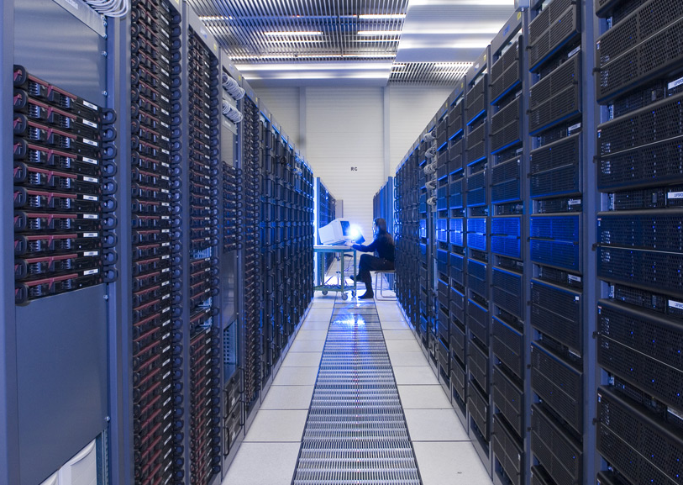
Data Center
A facility used to house computer systems and associated components

Slide 12
Distributed Servers
Servers host the resources needed by cloud users
Compute nodes
Provides CPU, Memory, Storage, Networking resources through virtualized interfaces.
Hosts guest operating systems (Virtual Machines)
Storage nodes
Compute nodes only provide temporary storage space for users/applications
Storage nodes provide long term data storage solutions
Administrative nodes
Provides “hidden” back-end services such as resource load balancing, databases, security/firewalls, cloud macro-management

Slide 13
Common Themes
In all clouds, someone else is providing the physical machines
You aren’t concerned about
Power
Bandwidth
Maintenance
physical security
scaling

Slide 14
Related terms & timeline
Utility Computing (1960s)
Cluster Computing (1960s)
Grid Computing (1990s)
Cloud Computing (2000s)
Fog Computing (2012)
Edge Computing (2020)

Slide 15
Cluster Computing
A collection of parallel or distributed computers which are interconnected among themselves using high-speed networks.
Clusters are used mainly for high availability, load-balancing and for compute purpose.
Computers in a cluster share computational workload as a single virtual computer.

Slide 16
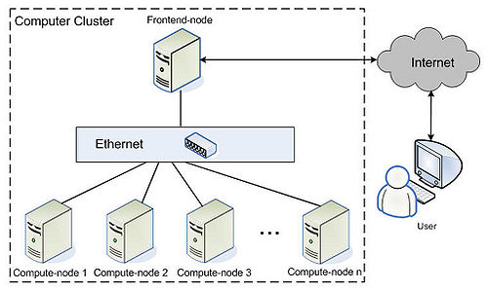
Cluster Computing

Slide 17
Grid Computing
Grid computing combines computer resources from multiple administrative domains/locations to reach a common goal, to solve a single task, and may then disappear just as quickly.
It enables the sharing, selection, and aggregation of geographically distributed autonomous resources dynamically at runtime depending on their availability, capability, performance, cost, and QoS requirements.
Grid computing is extended of cluster computing.

Slide 18
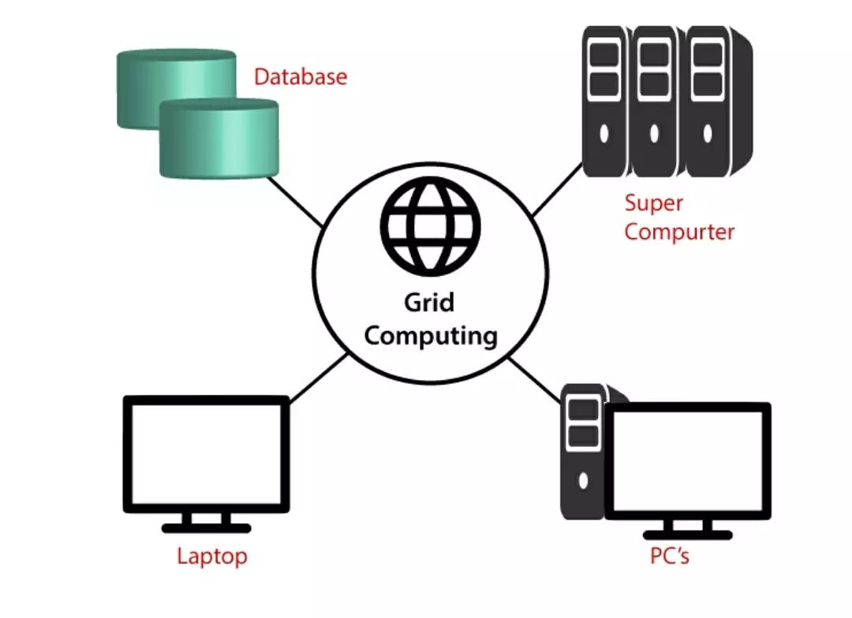
Grid Computing

Slide 19
Cluster, Grid & Cloud
Cluster computing is the base of all distributed computing paradigm, it aggregates resources locally and shares the load.
Grid computing is the extended version of cluster, in which resources are provisioned through internet.
Cloud is on top of all, it provides (more or less) the same functionalities as the above two but provides in the form of services and bills the same (utility).
Cloud is a marketing term

Slide 20
Cluster, Grid & Cloud
Scale
Cluster is a group of computers connected by a LAN, cloud and grid are more wide scale and can be geographically distributed
Coupling
Cluster is tightly coupled, grid or a cloud is loosely coupled
Hardware
Clusters are made up of machines with similar hardware, clouds and grids are made up of different hardware configurations

Slide 21
Cluster, Grid & Cloud
Resource distribution
Cloud computing is a centralized model , grid computing is a decentralized model where the computation could occur over many administrative domains.
Ownership
Cloud is a collection of computers usually owned by a single party; grid is a collection of computers which is owned by multiple parties in multiple locations
Examples
Clouds: Amazon Web Services (AWS), Google App Engine, Microsoft Azure, Dropbox, Gmail, Facebook, Youtube, Rapidshare, etc
Grid: FutureGrid

Slide 22
Cluster Configuration
Active-Active
Made up of at least two nodes, both actively running same service simultaneously.
The main purpose is to achieve load balancing.
improvement in throughput and response times.
Active-Passive
Consists of at least two nodes, but not all nodes are going to be active.
If the first is active, the second node must be passive or on standby.
Takes over when the active server gets disconnected or is unable to serve

Slide 23
Cluster, Grid & Cloud Computing
Parameter | Cluster | Grid | Cloud
Resource Handling | Centralized | Distributed | Both
Loose coupling / Scalable | No | Both | Yes
Reliability / User friendliness | No | Half | Full
Network type | Private | Private | Public Internet
Virtualization | Half | Half | Yes
Business Model | No | No | Yes
Task Size | Single large | Single large | Small, medium & large
Heterogeneity | No | Yes | Yes
Security | High | Medium / High | Low / Medium
Value Added Service | No | Both | Yes
Cost | Very High | High | Low

Slide 24
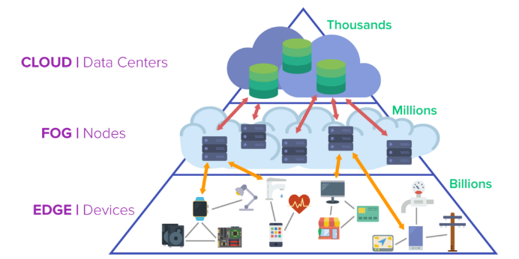
Cloud, Fog & Edge

Slide 25
Cloud, Fog & Edge
The main difference is where, when and how data from endpoint devices are processed and stored.
Cloud is the centralized storage situated further from the endpoints.
Highest latency, bandwidth cost, and network requirements.
But it is a powerful global solution that can handle huge amounts of data and scale effectively.
It works great for big data analytics, long-term data storage and historical data analysis.

Slide 26
Cloud, Fog & Edge
Fog acts as a middle layer between cloud and edge and provides the benefits of both.
It engages local computing and storage resources for real-time analytics and quick response to events.
Fog is decentralized meaning that it consists of many nodes.
But it has a network architecture. Fog nodes are connected with each other and can redistribute computing and storage to better solve given tasks.

Slide 27
Cloud, Fog & Edge
Edge is the closest you can get to end devices, hence the lowest latency and immediate response to data.
This approach allows to perform computing and store some (only limited) volume of data directly on devices, applications and edge gateways.
It usually has a loosely connected structure where edge nodes work with data independently.

Slide 28
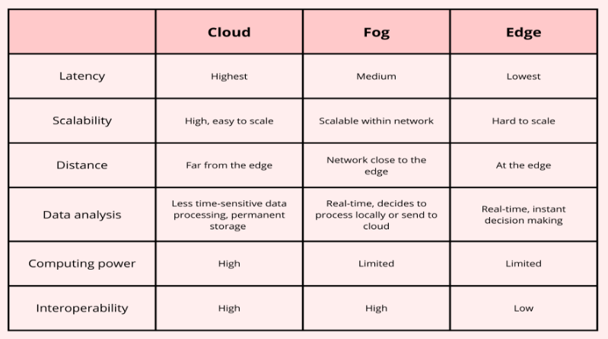
Cloud, Fog & Edge

Slide 29
Cloud Computing - Detail
Central ideas
Utility Computing
SOA - Service Oriented Architecture
SLA - Service Level Agreement
Enabling techniques
Hardware virtualization
Parallelized and distributed computing
Web service

Slide 30
User perspective
Users do not care about how the works are done
Instead, they only concern about what they can get
Users do not care about what the provider actually did
Instead, they only concern about their quality of service
Users do not want to own the physical infrastructure
Instead, they only want to pay as many as they used
What dose user really care?
They only care about their “Service”

Slide 31
Utility Computing
Service provisioning model
Service provider makes computing resources and infrastructure management available to the customer as needed
And charges them for specific usage rather than a flat rate
It seeks to maximize the efficient use of resources
And/or minimize associated costs

Slide 32
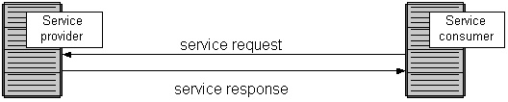
Service Oriented Architecture
SOA is a collection of services which communicate with each other
Contain a flexible set of design principles
Provide a loosely-integrated suite of services that can be used within multiple business domains
Usually implemented by Web Service model

Slide 33
Service Level Agreement
SLA is a contract between a service provider and a customer
It specifies what services the service provider will furnish
Performance guarantee metrics (QoS)
Up-time and down-time ratio
System throughput
Response time
Problem management detail
Penalties for non-performance
Documented security capabilities

Slide 34
Benefits of Cloud Computing
For the market and enterprises
Reduce initial investment
Reduce capital expenditure
Improve industrial specialization
Improve resource utilization
For the end user and individuals
Reduce local computing power
Reduce local storage power
Variety of thin client devices in daily life

Slide 35
Challenges in the cloud computing
Dynamic scalability
Multi-tenancy
Querying and access
Standardization
Reliability and fault-tolerance
Debugging and profiling
Security and privacy
Power

Slide 36
General Concerns
Each cloud systems uses different protocols and different APIs
Interoperability issue
Amazon has created its own DB system (not SQL 92), and workflow system
your normal applications will have to be adapted to execute on these platforms.
36

Slide 37
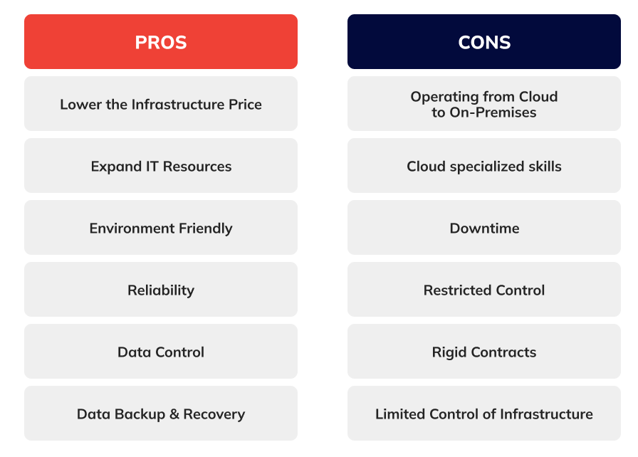
Cloud Computing – Pros & Cons

Slide 38
Thank you

